Slide 1
Deep learning
Unsupervised learning, VAE, GAN

Slide 2
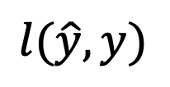
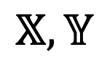
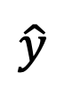
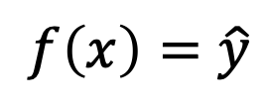
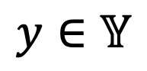
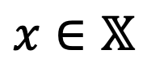
Supervised learning
The task of learning a function given input-output pairs.
Our dataset needs to be painstakingly labeled by humans.
The loss function drives the learning.
Regression
Classification
...
Network
Dataset
$$x∈𝕏$$
$$f\left(x\right)=\hat{y}$$
$$𝕏,𝕐$$
$$\hat{y}$$
$$y∈𝕐$$
$$l(\hat{y},y)$$
Loss
Notes:
Metrics are typically not differentiable, making them unsuitable for optimisation purposes
Metrics give you some indication of model performance for your domain

Slide 3
Unsupervised learning
Can we avoid labelling the data?
It can be costly.
Children do not need every example to be labelled.
How then do we evaluate the output of the network?
What is our output?
Network
Dataset
$$x∈𝕏$$
$$f\left(x\right)=\hat{y}$$
$$𝕏,𝕐$$
$$\hat{y}$$
$$y∈𝕐$$
$$l(\hat{y},y)$$
Loss
Notes:
Metrics are typically not differentiable, making them unsuitable for optimisation purposes
Metrics give you some indication of model performance for your domain

Slide 4
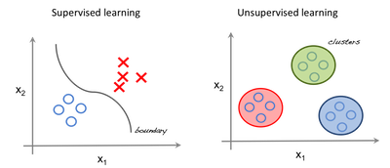
Unsupervised learning
Tasks
We try to learn relationships between the data.
Clustering / Probability density estimation
Dimensionality reduction
...
We tend to do this by estimating the probability distribution of the data.
Notes:
Metrics are typically not differentiable, making them unsuitable for optimisation purposes
Metrics give you some indication of model performance for your domain

Slide 5

Unsupervised learning
ML algorithms
There are many unsupervised learning ML algorithms.
Principal component analysis (PCA)
k-means clustering
Source: http://www.nlpca.org/pca_principal_component_analysis.html
Notes:
Metrics are typically not differentiable, making them unsuitable for optimisation purposes
Metrics give you some indication of model performance for your domain

Slide 6
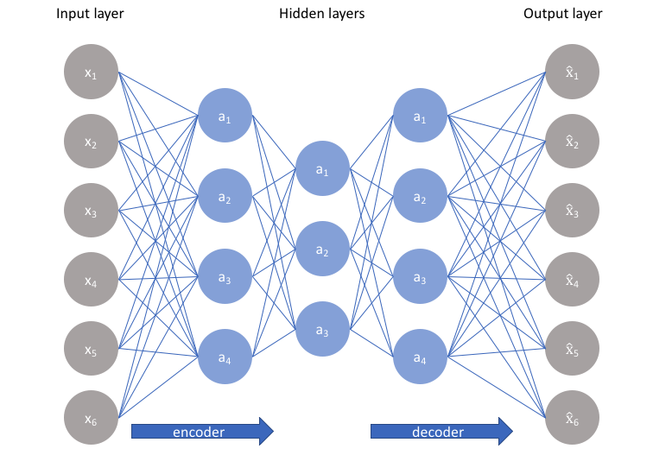
Unsupervised learning
DL models
DL models include
Autoencoders (Hinton, 2006, seminal paper)
Dimensionality reduction
Anomaly detection
Feature extractors
Generative Adversarial Networks (GANs) (Ian Goodfellow et al., 2014)
Probability Density estimation
Generative model
Autoencoder
Source: https://en.wikipedia.org/wiki/Autoencoder
Notes:
Metrics are typically not differentiable, making them unsuitable for optimisation purposes
Metrics give you some indication of model performance for your domain

Slide 7
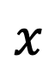
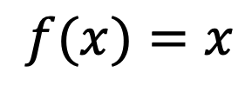
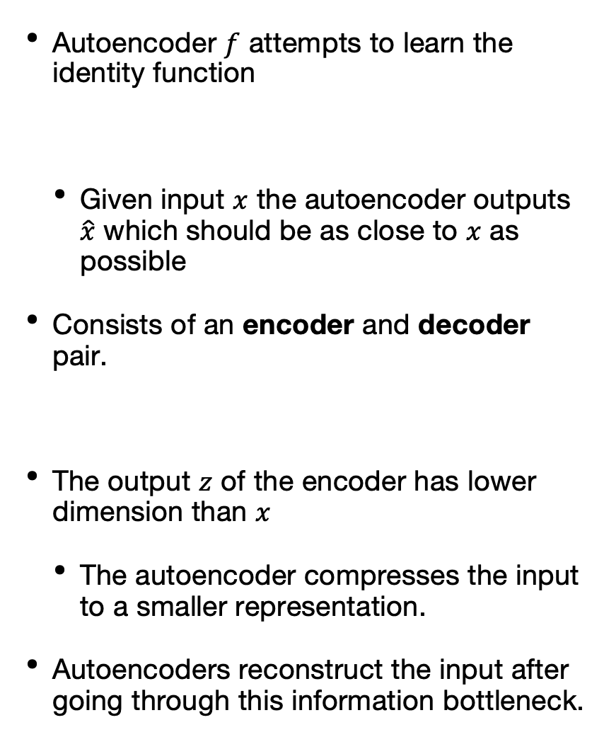
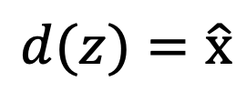
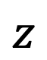
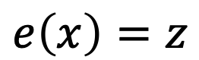
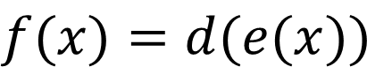
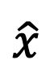
Autoencoder
Autoencoder $f$ attempts to learn the identity function
Given input $x$ the autoencoder outputs $\hat{x}$ which should be as close to $x$ as possible
Consists of an encoder and decoder pair.
The output $z$ of the encoder has lower dimension than $x$
The autoencoder compresses the input to a smaller representation.
Autoencoders reconstruct the input after going through this information bottleneck.
Encoder
Decoder
$$e\left(x\right)=z$$
$$d(z)=\hat{x}$$
$$f(x)=x$$
$$x$$
Latent space
$$\hat{x}$$
$$z$$
$$f(x)=d(e(x))$$
Source: https://en.wikipedia.org/wiki/Autoencoder

Slide 8
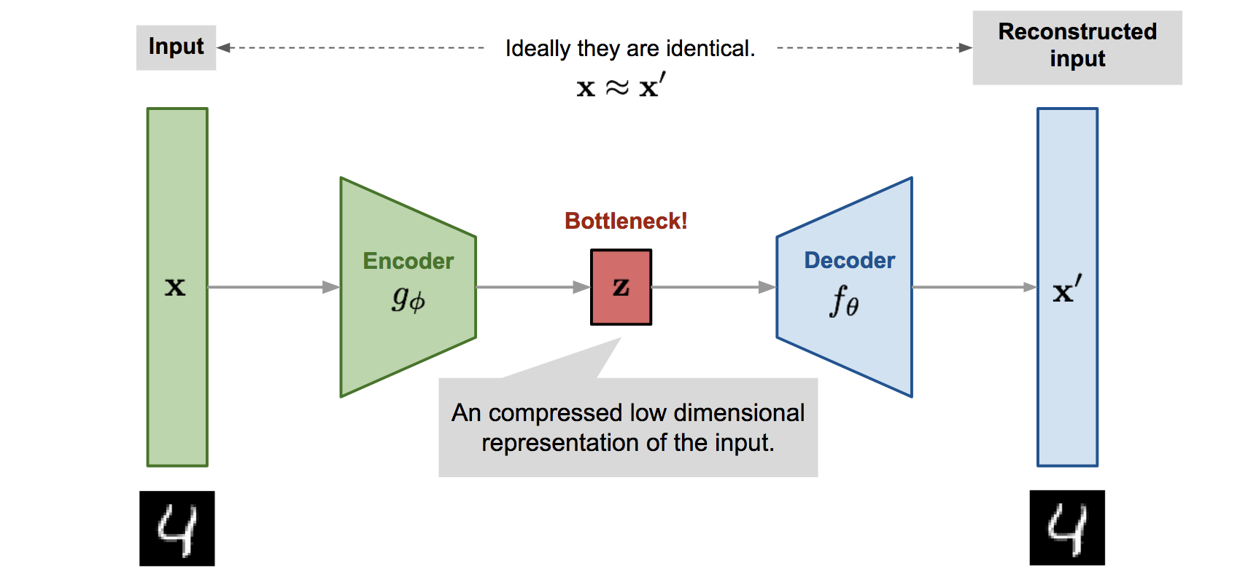
Autoencoder
Compression
We get a compressed representation/encoding of the input
Source: https://lilianweng.github.io/lil-log/2018/08/12/from-autoencoder-to-beta-vae.html

Slide 9
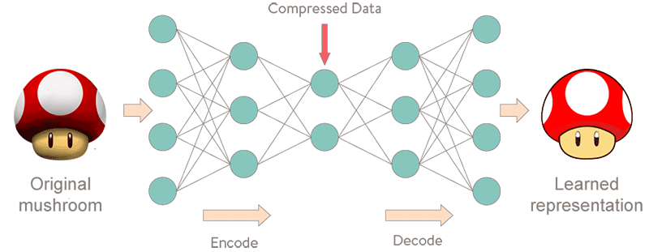
Autoencoder
Compression
A lossy compression.
Source: https://lilianweng.github.io/lil-log/2018/08/12/from-autoencoder-to-beta-vae.html

Slide 10
Autoencoder
Applications
Why is this useful?
Dimensionality reduction / Feature extraction.
Can be more expressive than PCA
PCA is linear
Autoencoder has multiple layers; non-linear activations
Apply "classical" algorithms on the compressed representation (z), e.g. k-means.
$$x$$
$$\hat{x}$$
$$z$$
Source: https://en.wikipedia.org/wiki/Autoencoder

Slide 11
Autoencoder
Applications
Why is this useful?
Anomaly detection
We have learnt to represent common features compactly
Anomalies have different features
High reconstruction error = anomaly.
$$x$$
$$\hat{x}$$
$$z$$
Source: https://en.wikipedia.org/wiki/Autoencoder

Slide 12
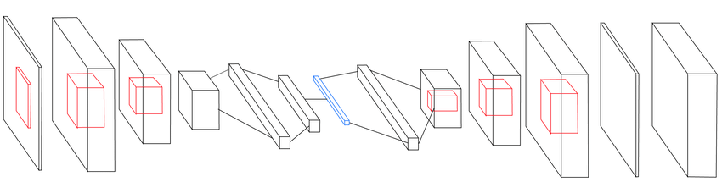
Autoencoder
Implementations
The encoder and decoder can be.
Fully connected (dense) with many layers
Convolutional.
...
Source: Exploration: A Study of Count-Based Exploration for Deep Reinforcement Learning (2016, Tang et al.)

Slide 13
Autoencoder
Implementations
Code example: https://blog.keras.io/building-autoencoders-in-keras.html

Slide 14
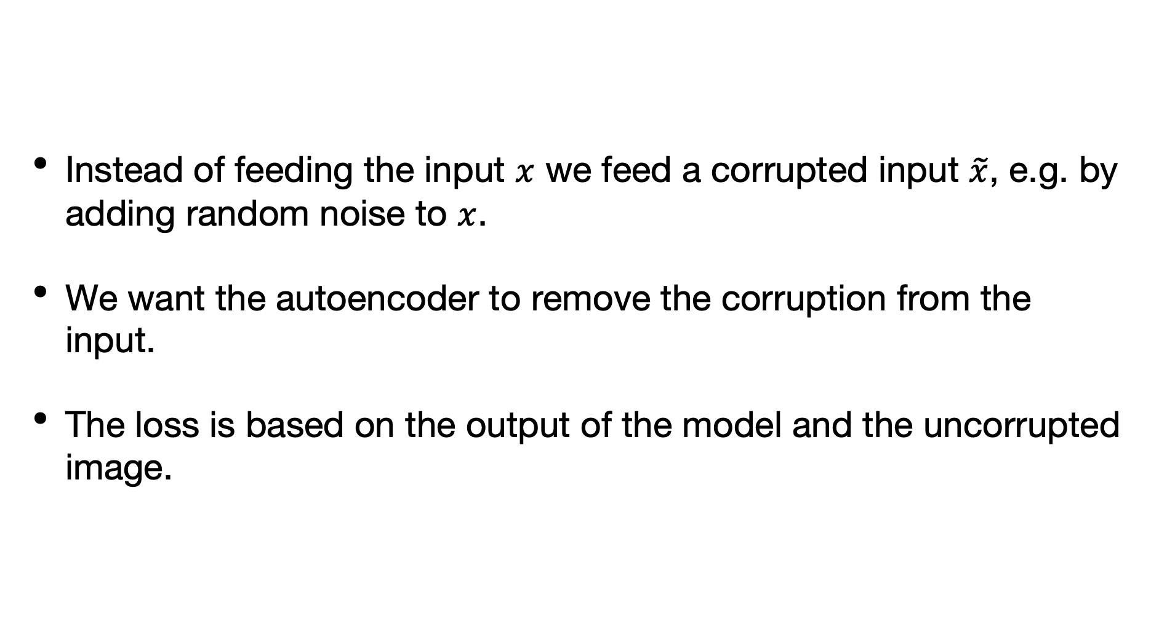
Autoencoder
Denoising autoencoder (2008, Vincent et al.)
Instead of feeding the input $x$ we feed a corrupted input $\tilde{x}$, e.g. by adding random noise to $x$.
We want the autoencoder to remove the corruption from the input.
The loss is based on the output of the model and the uncorrupted image.

Slide 15
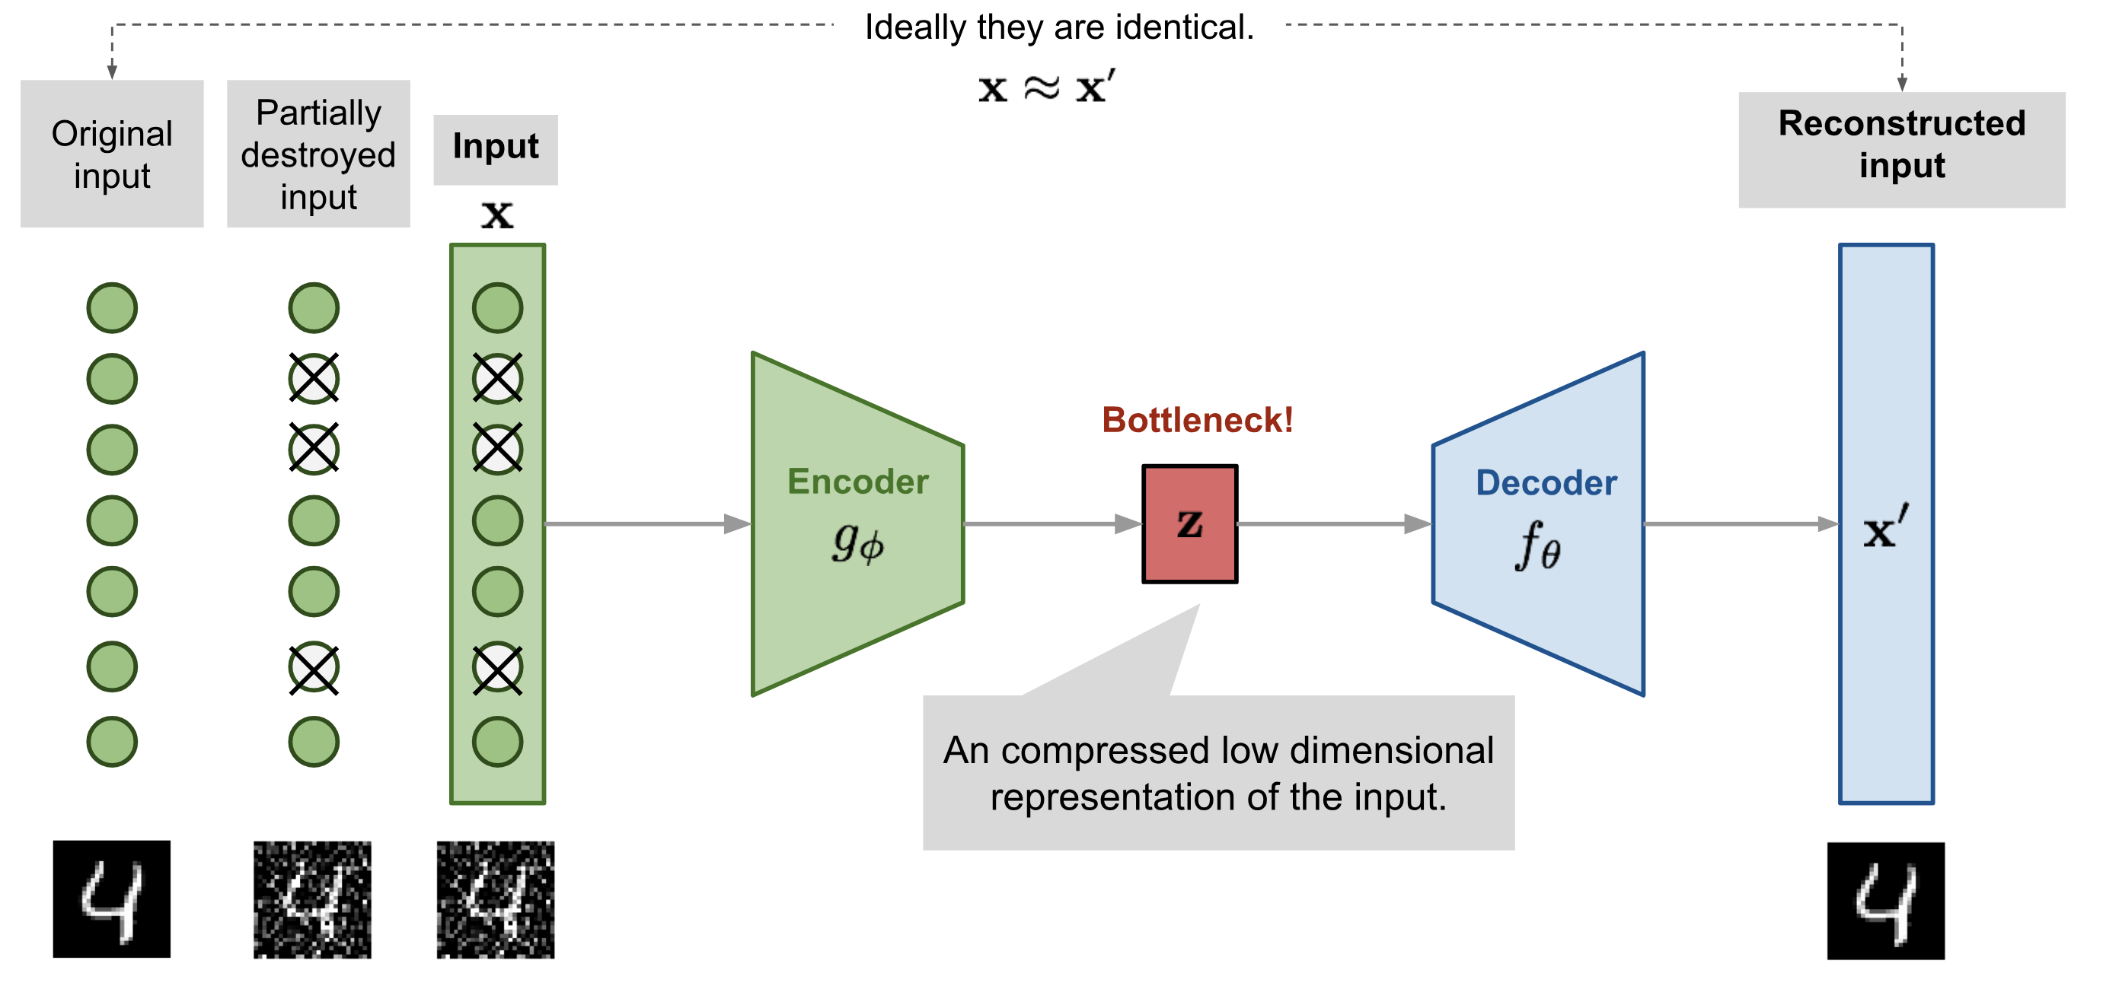
Autoencoder
Denoising autoencoder
Source: https://lilianweng.github.io/lil-log/2018/08/12/from-autoencoder-to-beta-vae.html

Slide 16
Autoencoder
Denoising autoencoder
Why is this useful?
We learn to detect more robust features.
Precursor to dropout (2012, Hinton et al.)
Source: https://lilianweng.github.io/lil-log/2018/08/12/from-autoencoder-to-beta-vae.html

Slide 17
Autoencoder
other autoencoders
There are more variations of autoencoders which apply different constraints on the learnt representation, the latent space.
These constraints are applied by adding terms to the loss function (like regularisation).
They are sometimes called regularised autoencoders.
Take-home message, to apply different constraints, add terms to your loss function. This is very common.

Slide 18
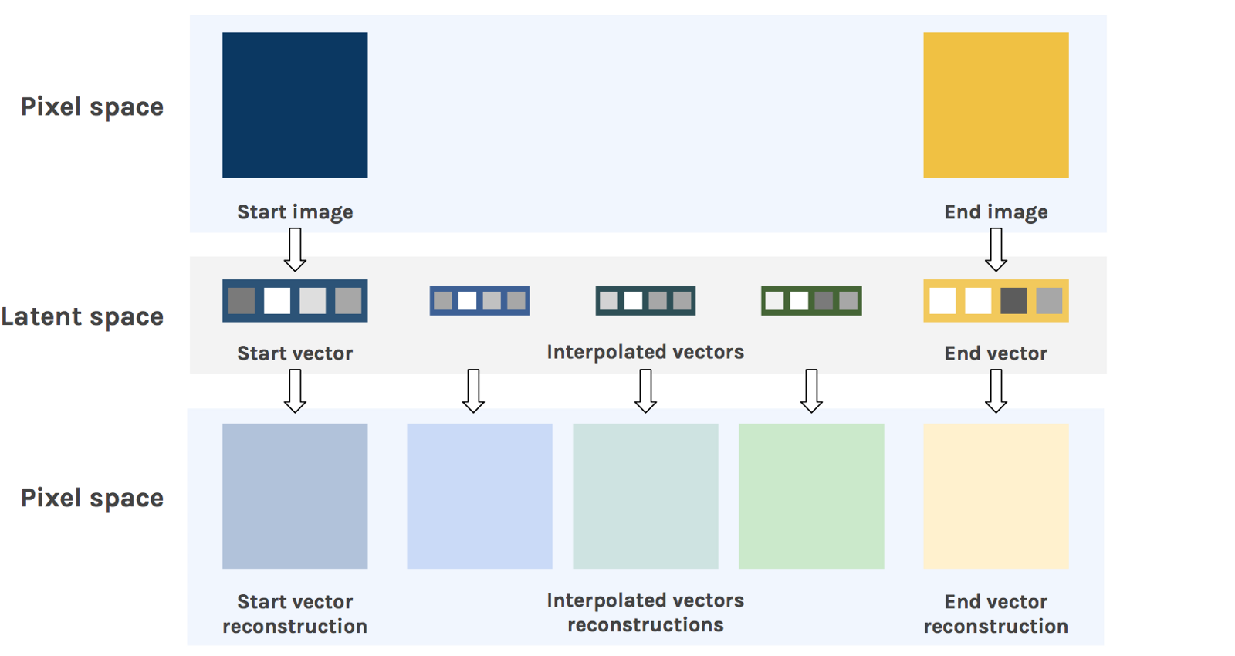
Autoencoder
Interpolation
Can we get novel images by interpolation in the latent space?
Interpolation is the process of creating new datapoints between existing datapoints.
Source: https://hackernoon.com/latent-space-visualization-deep-learning-bits-2-bd09a46920df

Slide 19
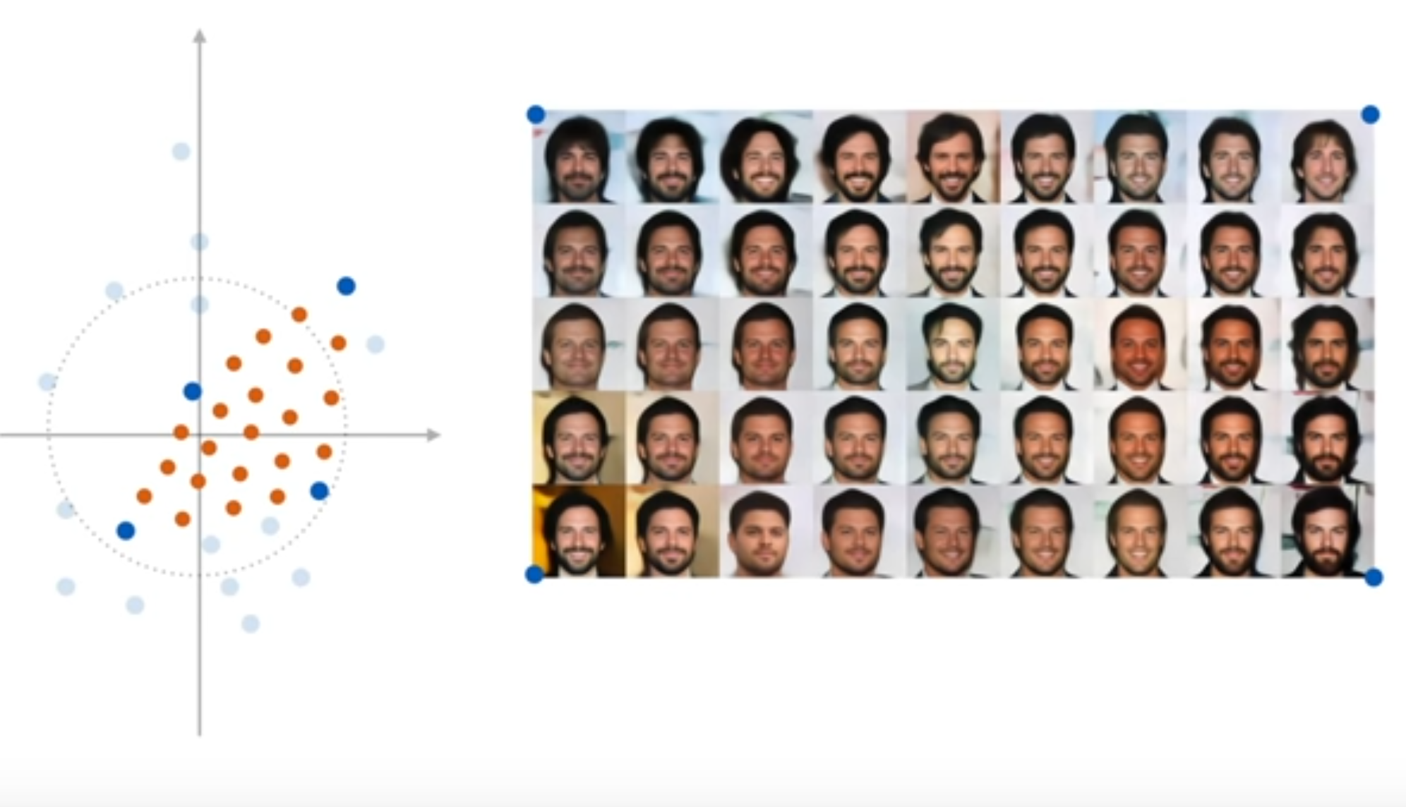
Autoencoder
Interpolation
Source: Peter Bloem, VU ML course 2019.

Slide 20
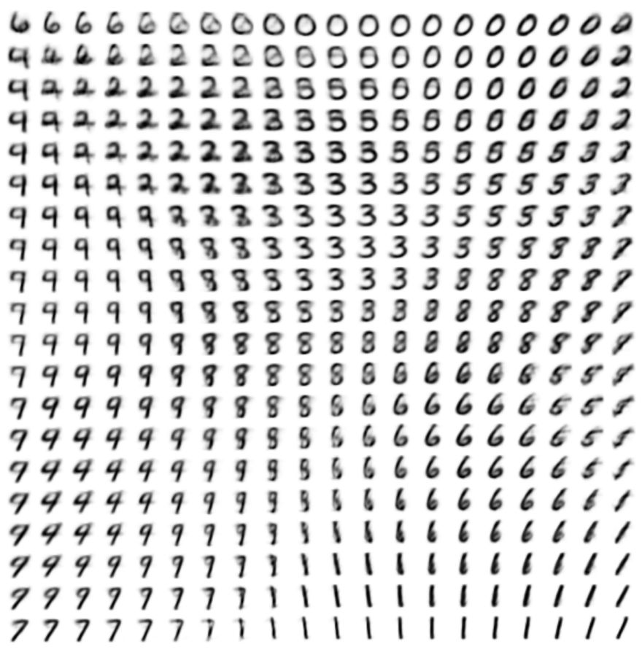
Autoencoder
Interpolation
Source: https://ermongroup.github.io/cs228-notes/extras/vae/

Slide 21
Variational Autoencoder
The latent space in normal autoencoders does not allow us to do this well.
The space is "not smooth" so the output is very distorted.
When we decode some latent representations we get garbage out.
The variational autoencoder (VAE) (2014, Kingma & Welling) allows us to do this by adding some randomness to our latent space.
By making the decoder deal with some randomness, the latent space becomes more smooth.

Slide 22
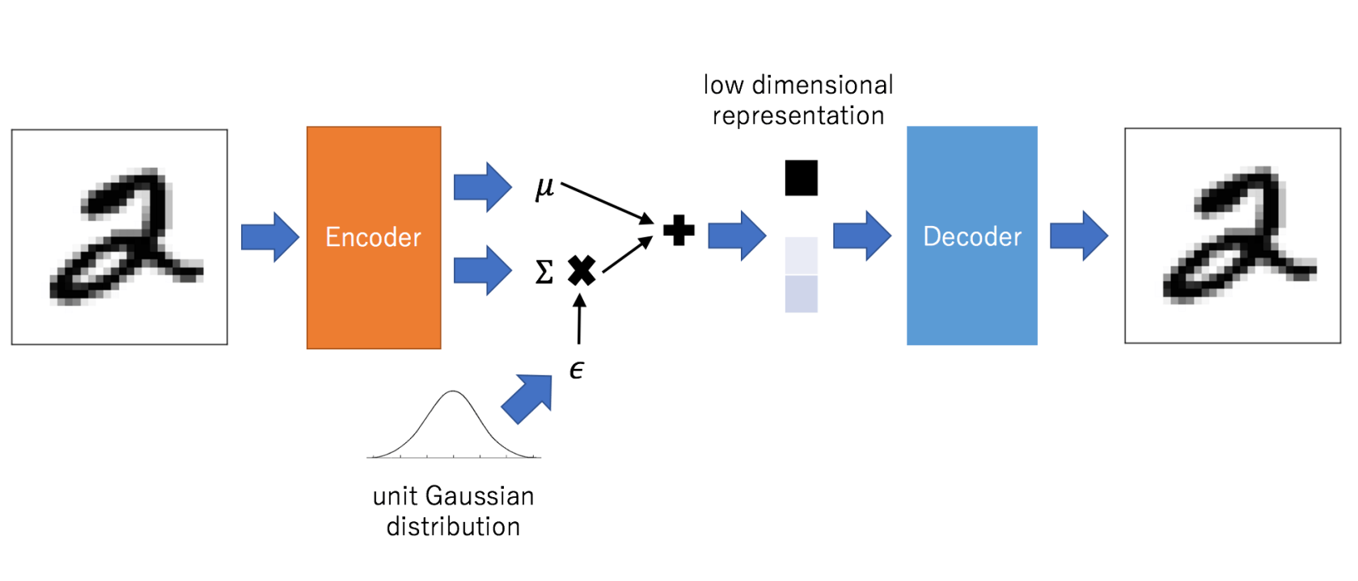
Variational Autoencoder
The encoder outputs the parameters (mean and standard deviation) for a multinomial (many dimensions) normal distribution.
We then sample a vector as the representation for the input.
We have just added some random elements to our model.

Slide 23
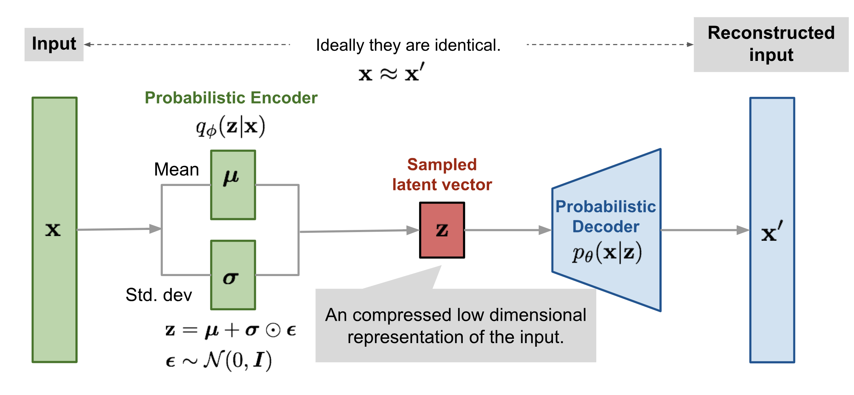
Variational Autoencoder

Slide 24
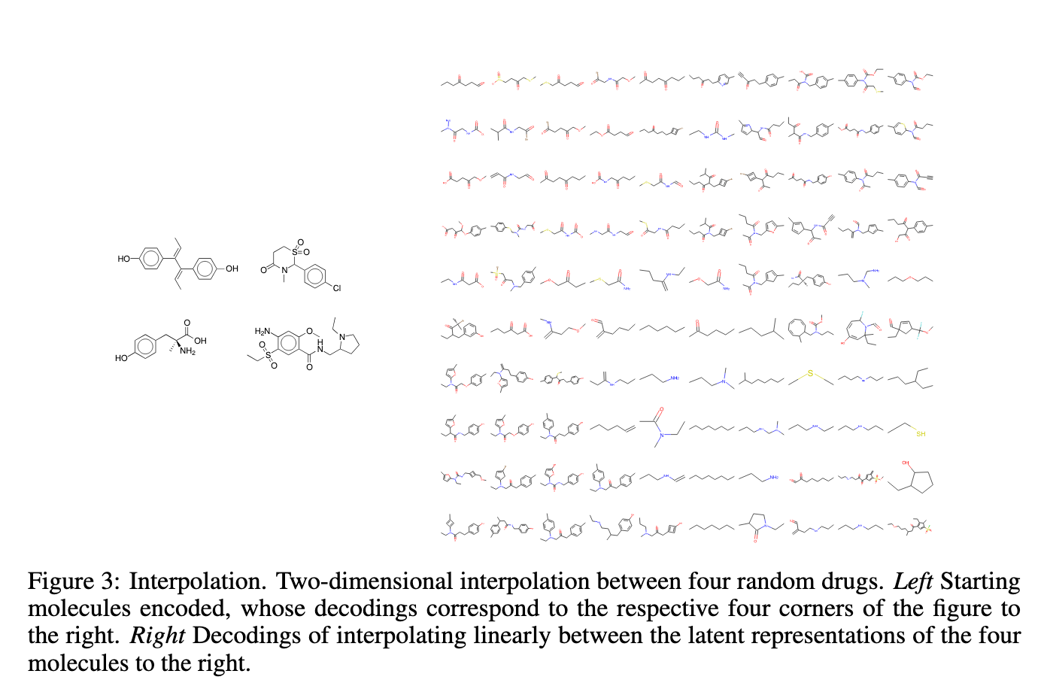
Variational Autoencoder
Source: Automatic Chemical Designusing Variational Autoencoders (2016, Gómez-Bombarelli et al.)

Slide 25
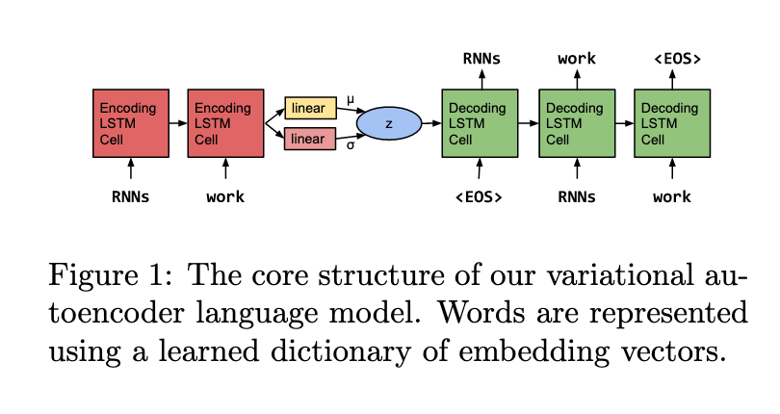
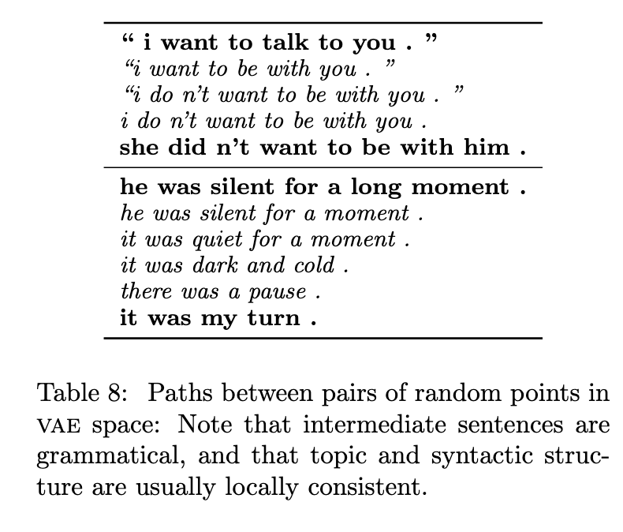
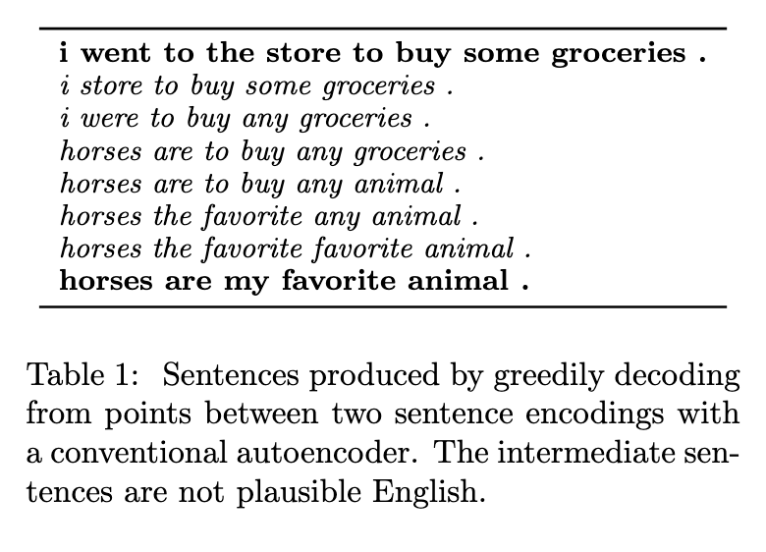
Variational Autoencoder
Variational Autoencoder
Autoencoder
Source: Generating Sentences from a Continuous Space (2016, Bowman et al.)

Slide 26
Variational Autoencoder
The latent space in VAEs is (mostly) smooth in the sense that if we interpolate in that space we get something novel, something which was not trained on but looks "real".
To make sure that the latent space follows the rules which we expect (e.g. grammatical rules), we need to add extra terms to our loss function, so that when something breaks these rules, additional loss is applied.

Slide 27

Hands-on
Go to https://jupyter.lisa.surfsara.nl:8000
or https://dba.projects.sda.surfsara.nl/
Notebook: 07-autoencoder.ipynb
19:30-20:15

Slide 28
Adversarial attacks
All classifiers are deterministic, most DL models are after they have been trained.
We just saw VAEs which are not deterministic, but they are not classifiers.
People can "game" these classifiers.

Slide 29
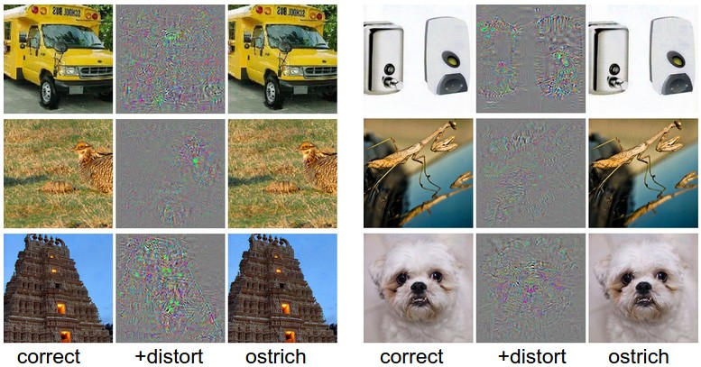
Adversarial attacks
Starting from 2014, researchers conducted adversarial attacks.
https://www.youtube.com/watch?v=PrU9R6eFNTs
Source: https://karpathy.github.io/2015/03/30/breaking-convnets/

Slide 30
Adversarial attacks
To begin with classifiers were trained additionally on the adversarial images, but that does not scale.
Instead, let us try to detect real and fake images, then we can always detect adversarial attacks.
We create fake images from random noise, this is the generator.
We then train a classifier to detect whether the images are from the generator (fake) or whether they are real, this is the discriminator.
The network is then in two parts, the generator and the discriminator.
The generator wants the discriminator to think that the images are real, while the discriminator wants to tell real images from fake.
It is a min-max game.

Slide 31

GANs
Source: https://medium.freecodecamp.org/an-intuitive-introduction-to-generative-adversarial-networks-gans-7a2264a81394

Slide 32
GANs
For each input image we do two weight updates, one to update the weights of the generator and another for the discriminator.
As time goes on during training, the generator gets better and better and in the end the discriminator is can only guess.
Then we have a generator which can create realistic images from the same domain as the training data.

Slide 33
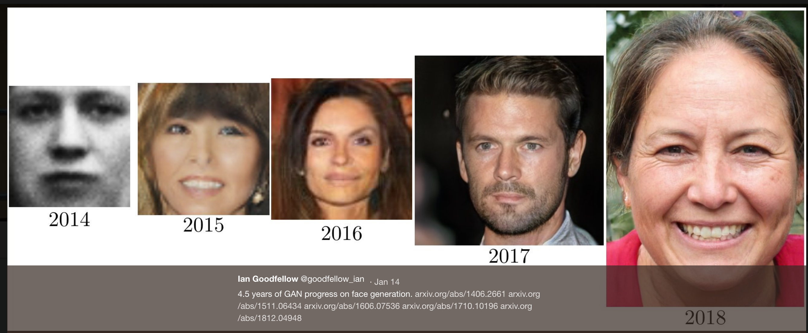
GANs
Source: https://www.jeremyjordan.me/convnet-architectures/

Slide 34

GANs
Source: https://www.jeremyjordan.me/convnet-architectures/

Slide 35
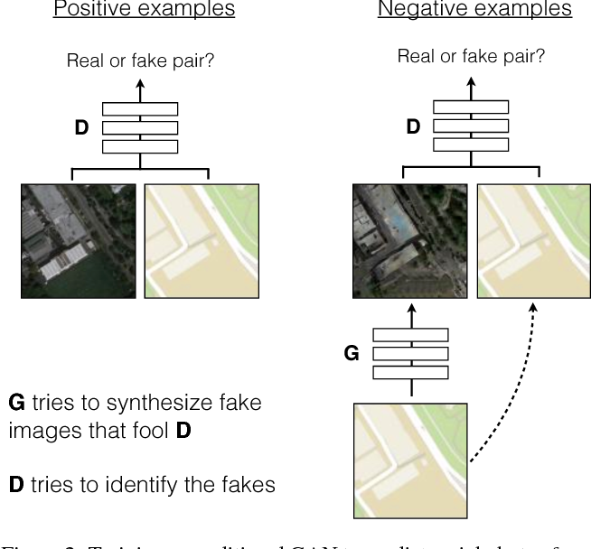
Conditional GANs
Instead of asking whether and image is fake or real, we ask for a pair of images.
The generated image (left) may be very realistic, but if it doesn’t match with the condition (right), the detector will identify it as fake!
Source: Image-to-Image Translation with Conditional Adversarial Networks (2016, Isola et al.)

Slide 36
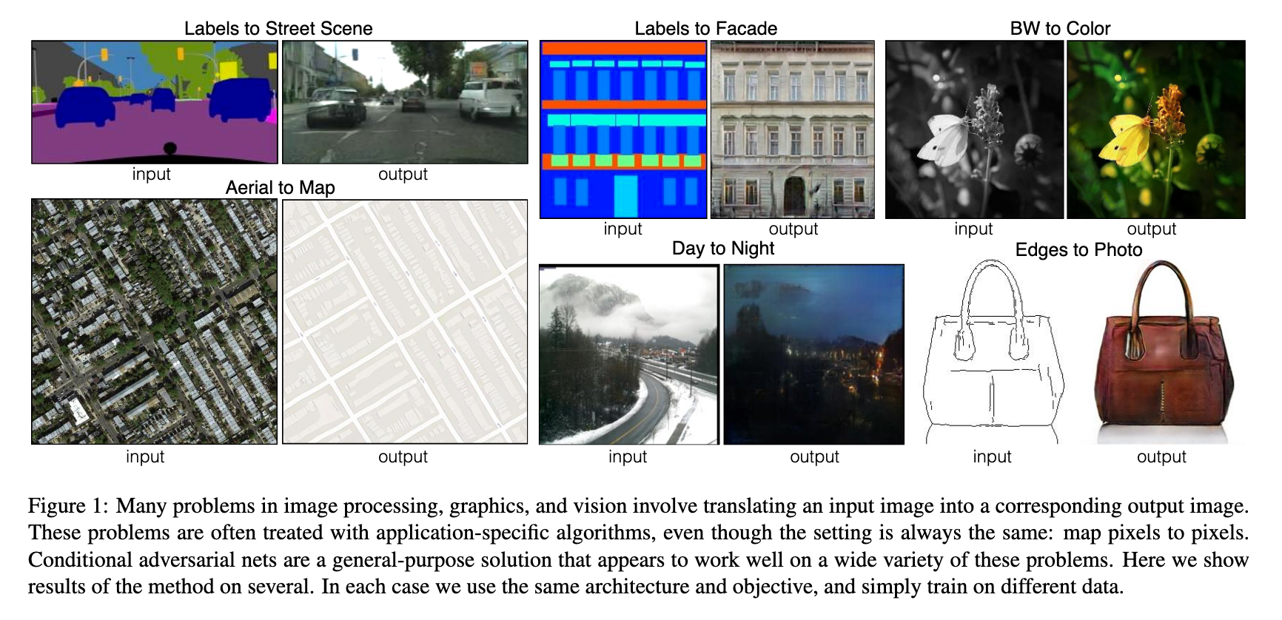
Conditional GANs
Source: Image-to-Image Translation with Conditional Adversarial Networks (2016, Isola et al.)

Slide 37
cycle GANs
The problem with conditional GANs is that for each outline there must be a correctly filled in image to train on.
Having to find a training data which consists of pairs of images is hard, and sometimes they do not even exist!
Cycle GANs address this problem by considering mappings between two distinct datasets.
Source: Unpaired Image-to-Image Translationusing Cycle-Consistent Adversarial Networks (2017, Zhu et al.)

Slide 38
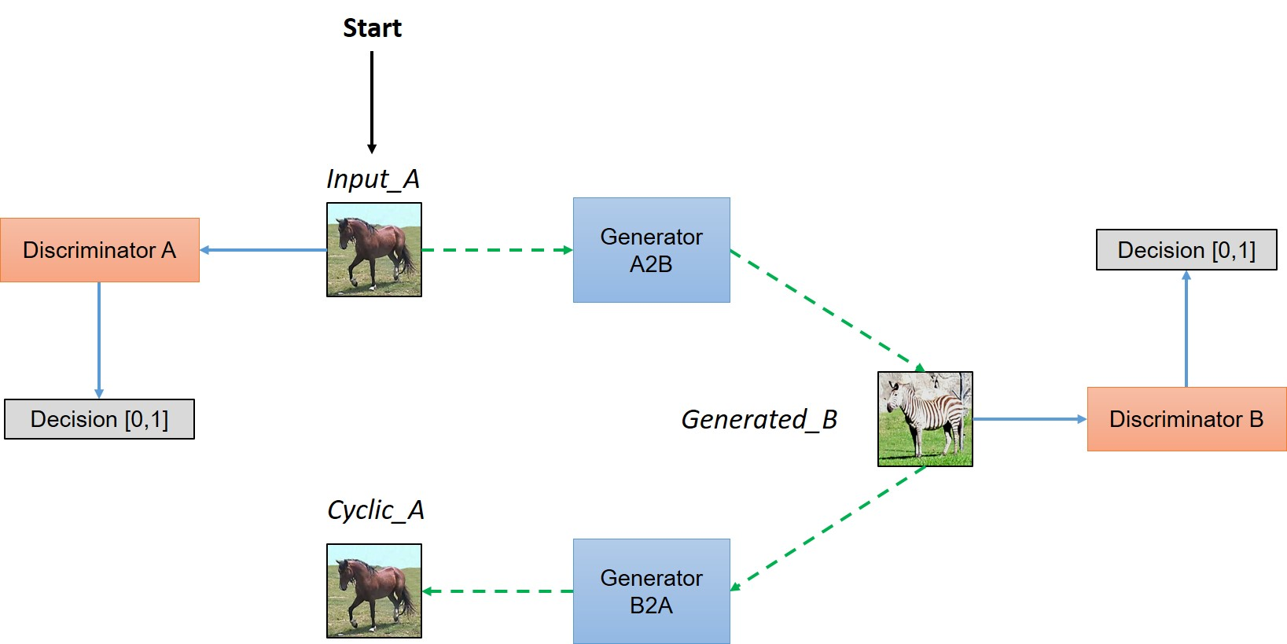
cycle GANs
Source: Unpaired Image-to-Image Translation using Cycle-Consistent Adversarial Networks (2017, Zhu et al.)

Slide 39
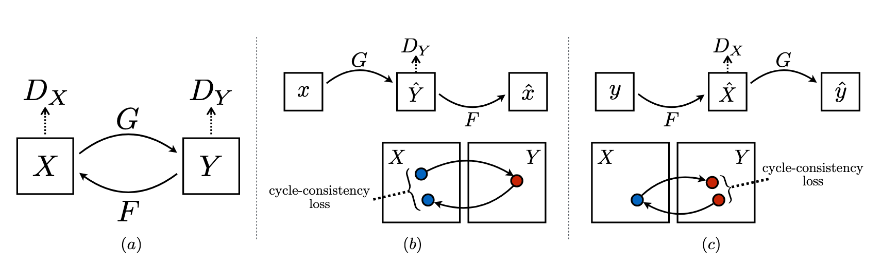
cycle GANs
The loss function is not just the adversarial loss, but also the cycle-consistency loss.
Source: Unpaired Image-to-Image Translation using Cycle-Consistent Adversarial Networks (2017, Zhu et al.)

Slide 40
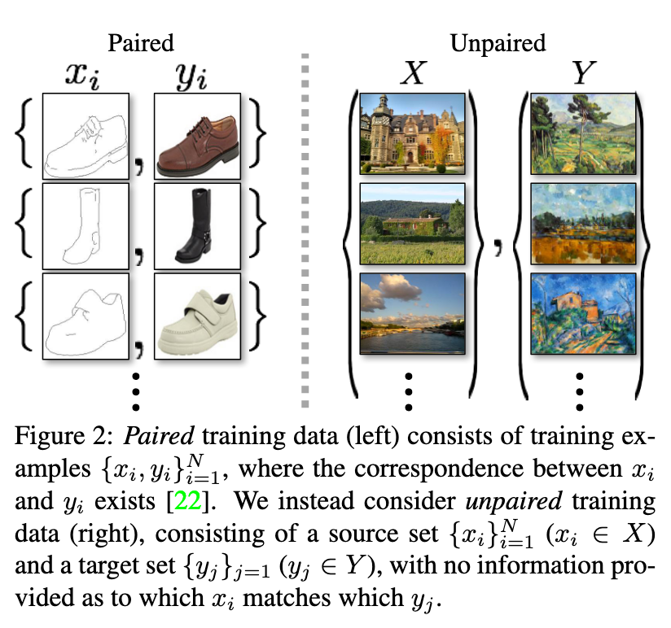
cycle GANs
Source: Unpaired Image-to-Image Translation using Cycle-Consistent Adversarial Networks (2017, Zhu et al.)

Slide 41
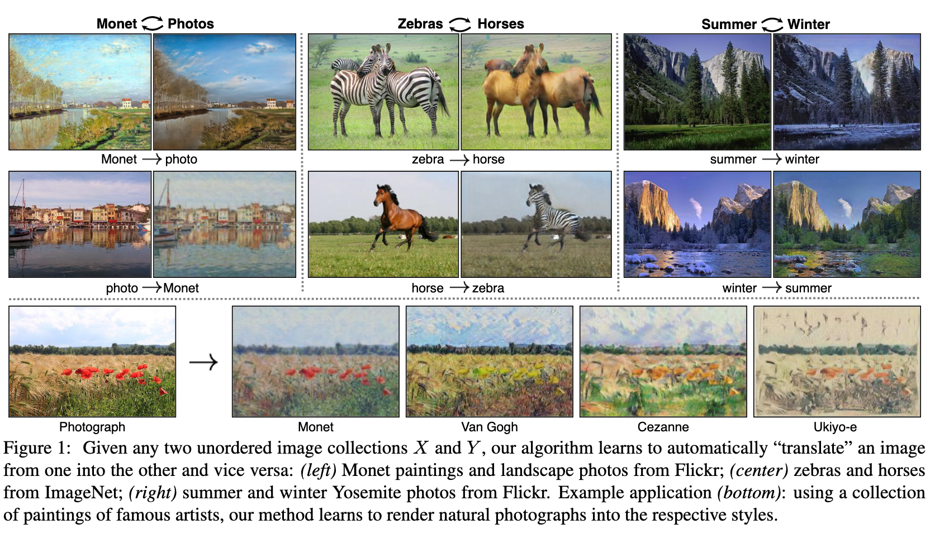
cycle GANs
Source: Unpaired Image-to-Image Translation using Cycle-Consistent Adversarial Networks (2017, Zhu et al.)

Slide 42
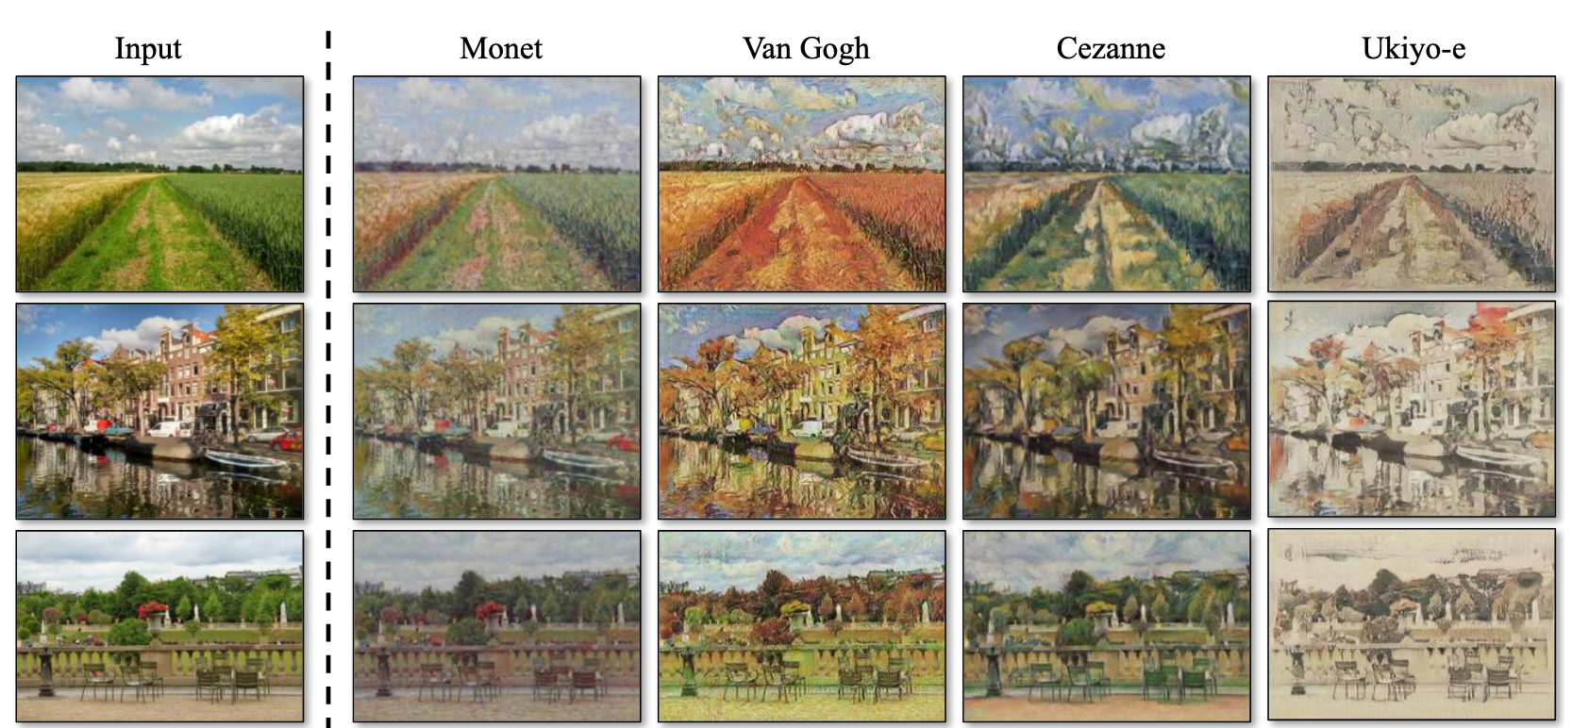
cycle GANs
Source: Unpaired Image-to-Image Translationusing Cycle-Consistent Adversarial Networks (2017, Zhu et al.)

Slide 43
cycle GANs
https://resources.wolframcloud.com/NeuralNetRepository/tasktype/Image-Processing/
https://github.com/junyanz/CycleGAN

Slide 44
style GANs
Images from GANs can be blurry and lack finer details.
Style GANs address this problem by adding random noise at multiple stages in the image generation process.
First, a single random vector is sampled and used everywhere in the generation process, this is the overarching style of the image.
Then multiple others are sampled during the process.

Slide 45
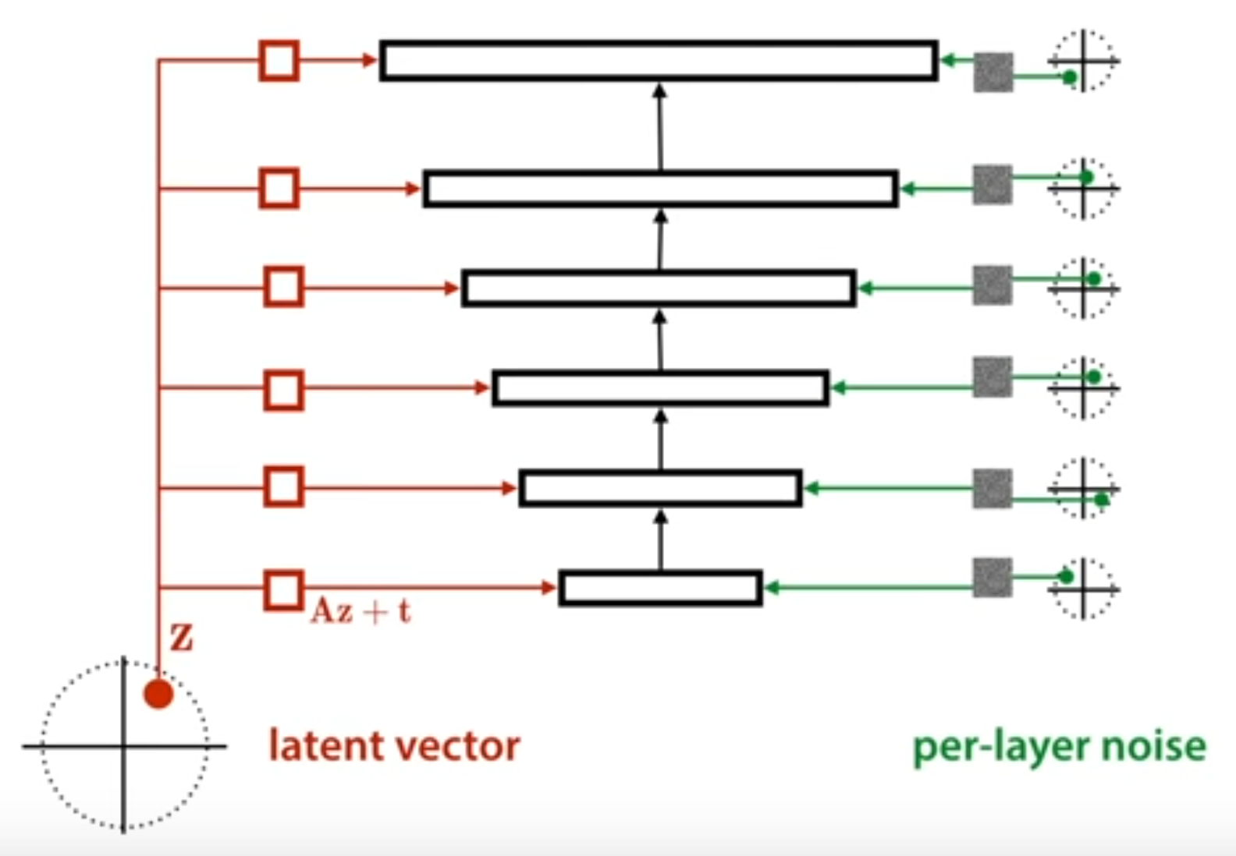
cycle GANs
Source: A Style-Based Generator Architecture for Generative Adversarial Networks (2018, Karras et al. )

Slide 46
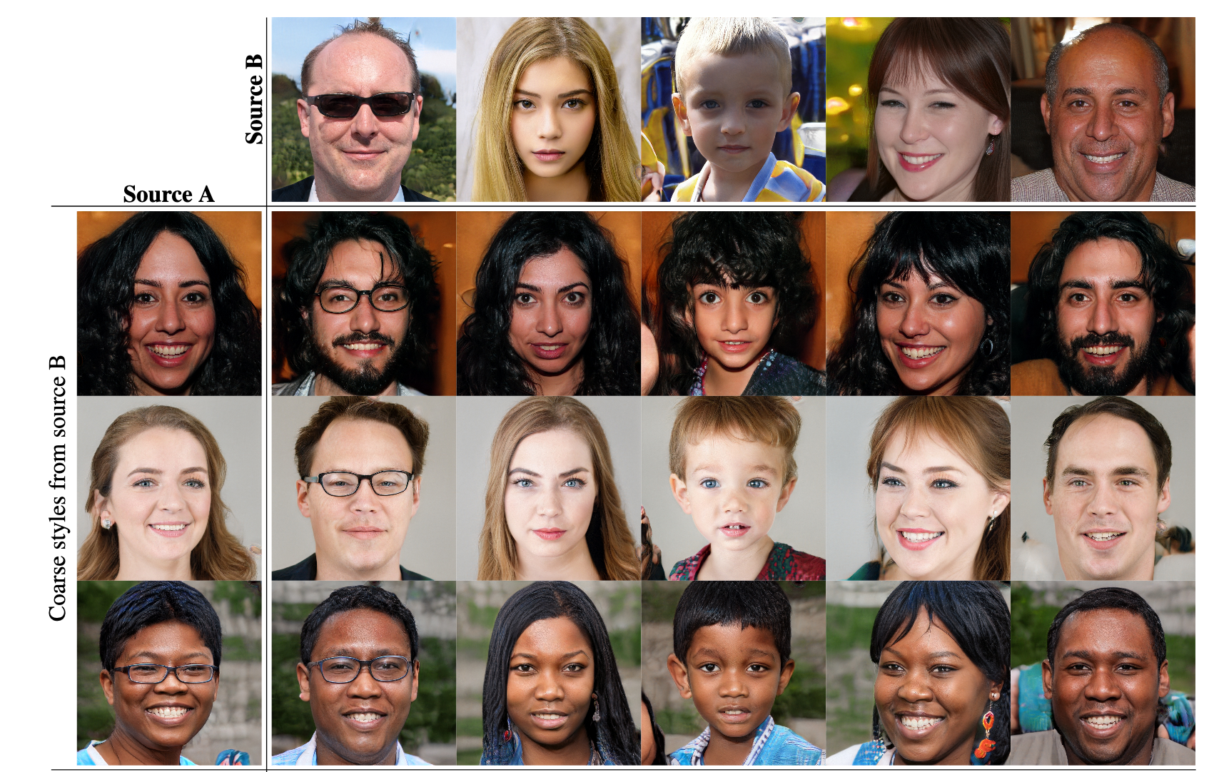
style GANs
Source: A Style-Based Generator Architecture for Generative Adversarial Networks (2018, Karras et al. )

Slide 47
VAEs vs GANs
Both learn the distribution of the data, i.e. they are generative.
GANs are better for images,
VAEs work better for data with some structure (music, language)
VAEs have a strong mathematical foundation, GANs do not.
Unknown what is being optimised for GANs.

Slide 48
Thank you!
Thank you for your interest, you were a very engaging group!
Remaining questions?
Please fill out the feedback form!

